Slide 1
Driver Quick Start Guide

Slide 2
03
Getting Started
11
Roadside Inspections
04
Selecting Equipment and Getting Connected
12
End of Day Procedure
06
What Am I Required to Log
14
Paper Logs
07
Changing Duty Status
15
Reminders
08 Certifying Logs
16
Support
09
Pre & Post Trip Inspections

Slide 3
Getting Started
1
2
3
Download the app on your tablet or phone:
Log in with credentials provided by your Fleet Manager or Support. Pressing the “Forgot Password” link will generate an email to your email address on file with a link to reset your password.
Upon first log in, please choose Allow for location services. Choose OK to allow the app to use bluetooth. Choose All to receive push notifications.

Slide 4
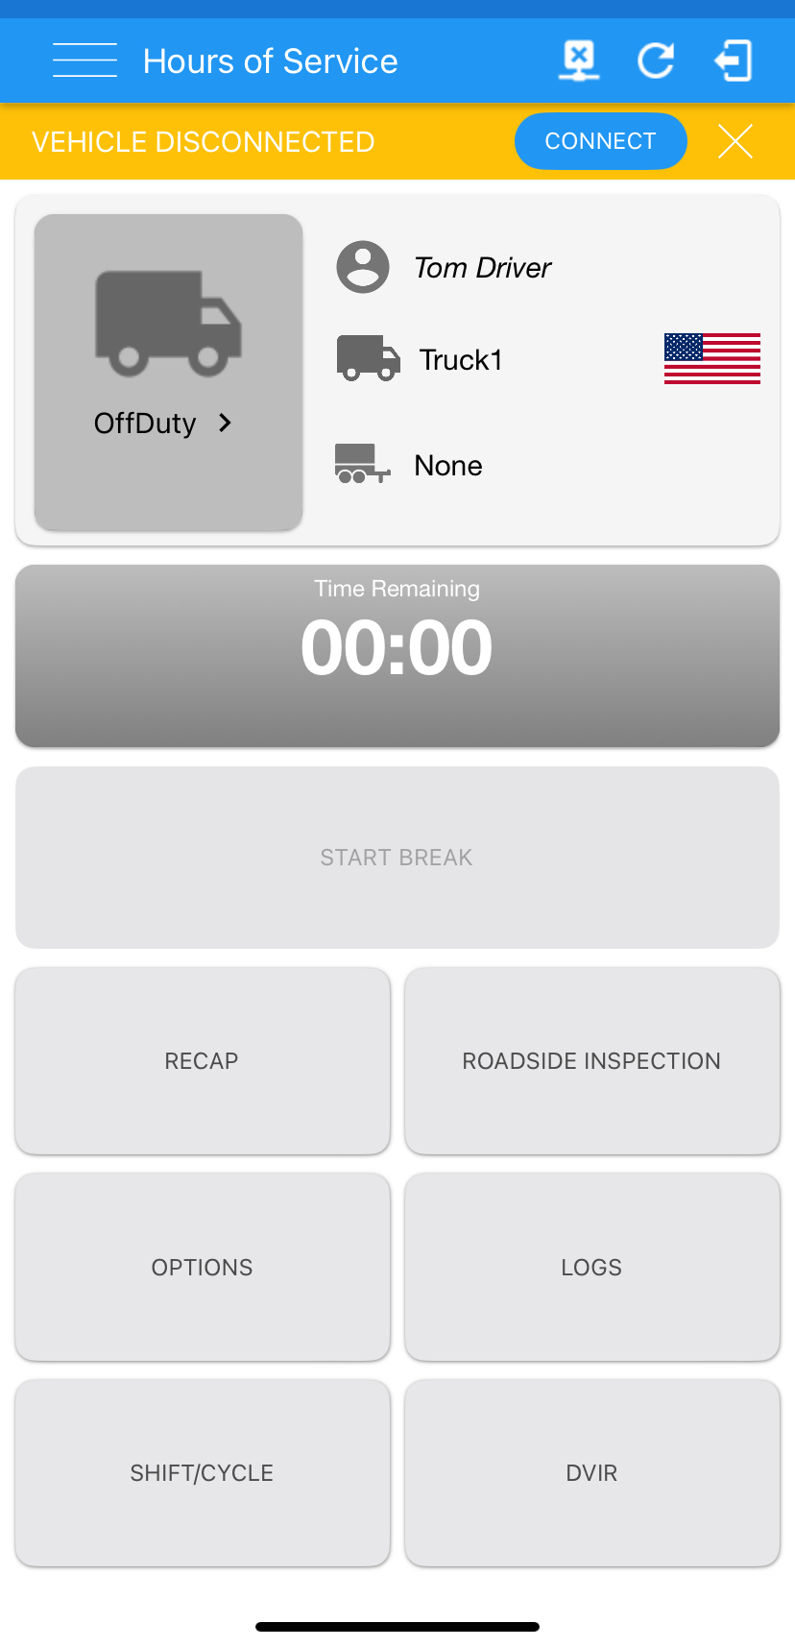
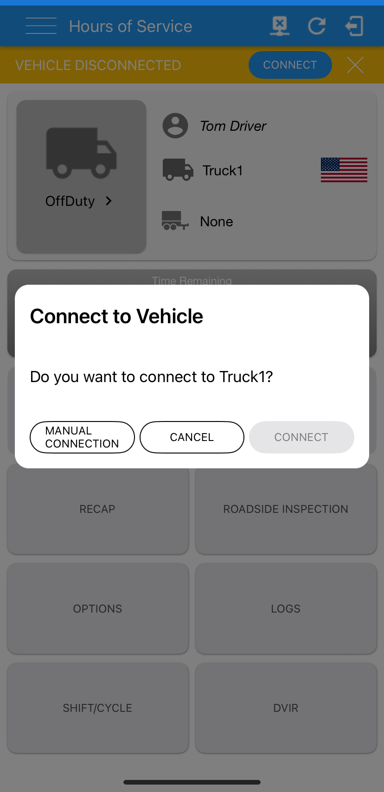
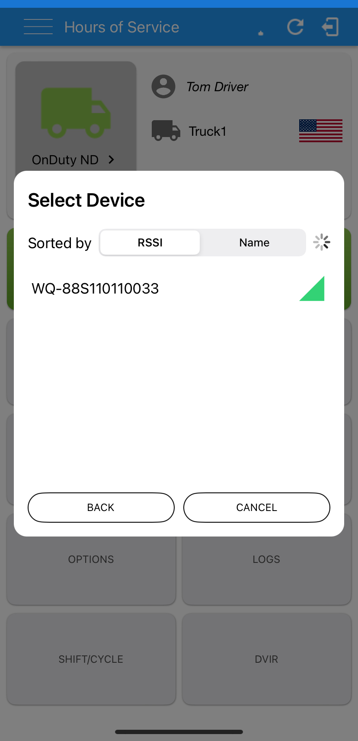
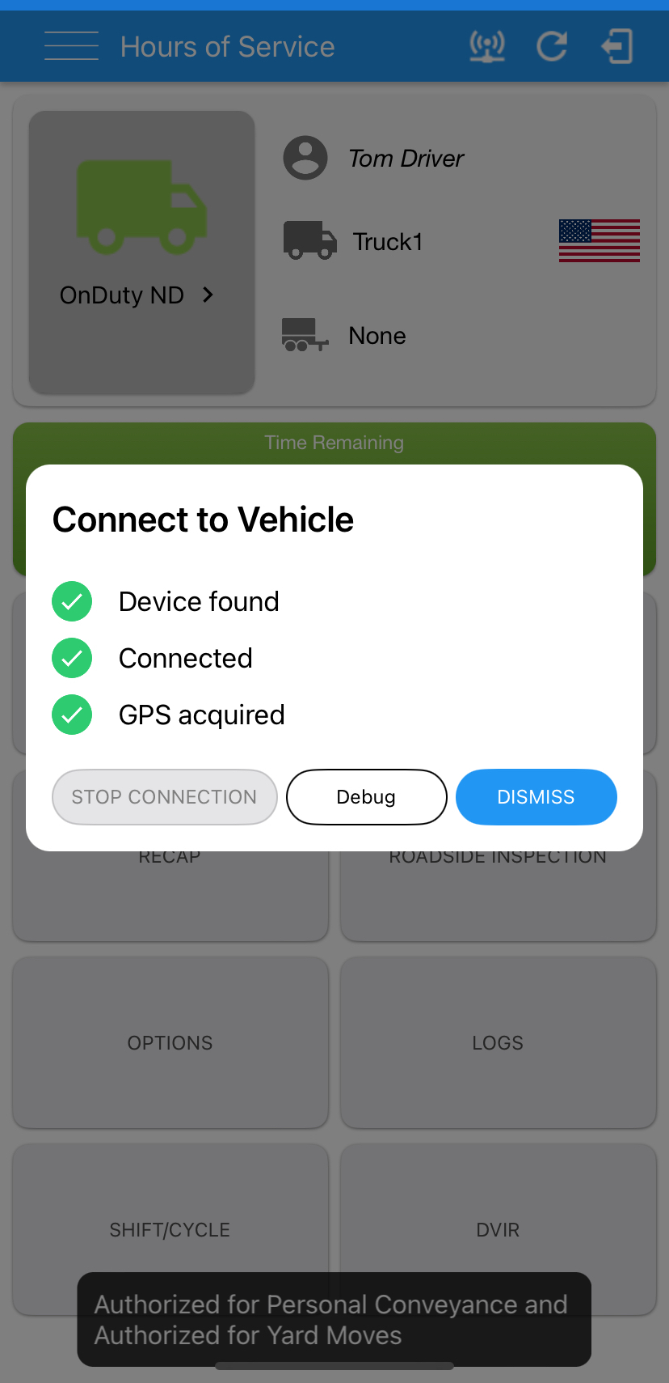
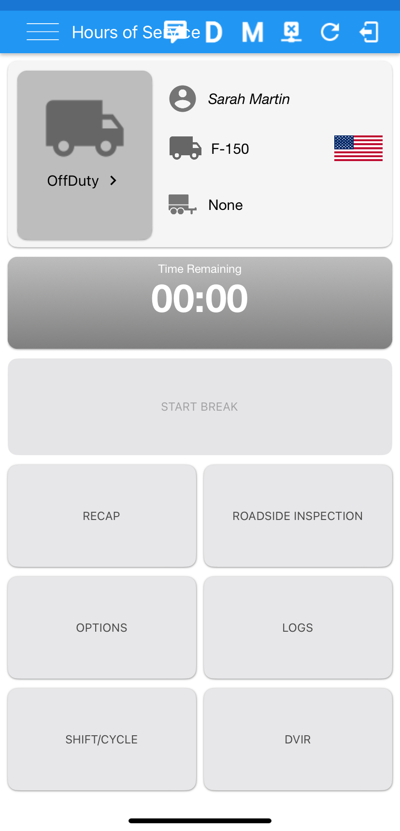
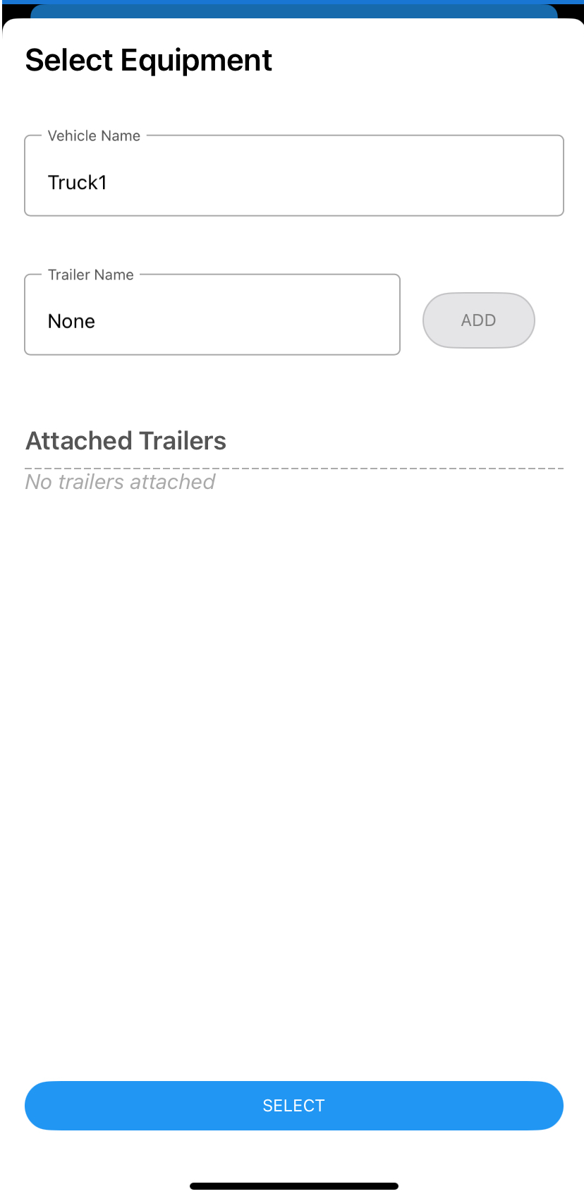
Selecting Equipment and Getting Connected
Review the currently assigned Equipment. If you’ll be driving a different vehicle, tap OPTIONS, choose SWITCH EQUIPMENT, and select your equipment from the drop down menus. Tap SELECT to save your selection.
The orange banner indicates that you are not properly connected to your device. Tap the blue CONNECT button. Choose to connect automatically if available, or manually if not. The app will scan for devices via Bluetooth; select the unit in your vehicle.
Your engine must be running to allow the device to properly read engine data, and sync with the application.
Once connected, the Diagnostics, Malfunction, and VBUS connections icons will appear on the main screen. A yellow M or an X on the VBUS icon indicate a loss of connection, press the VBUS icon to reconnect.

Slide 5
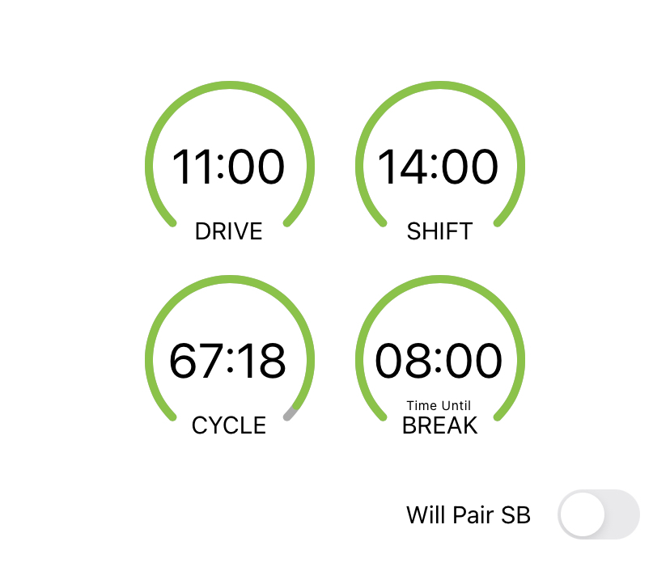
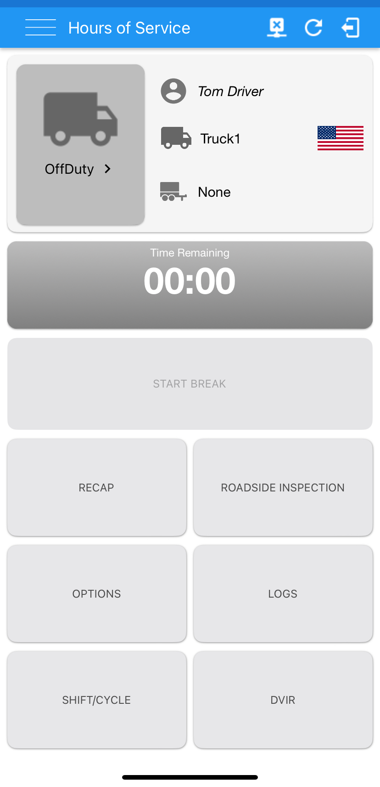
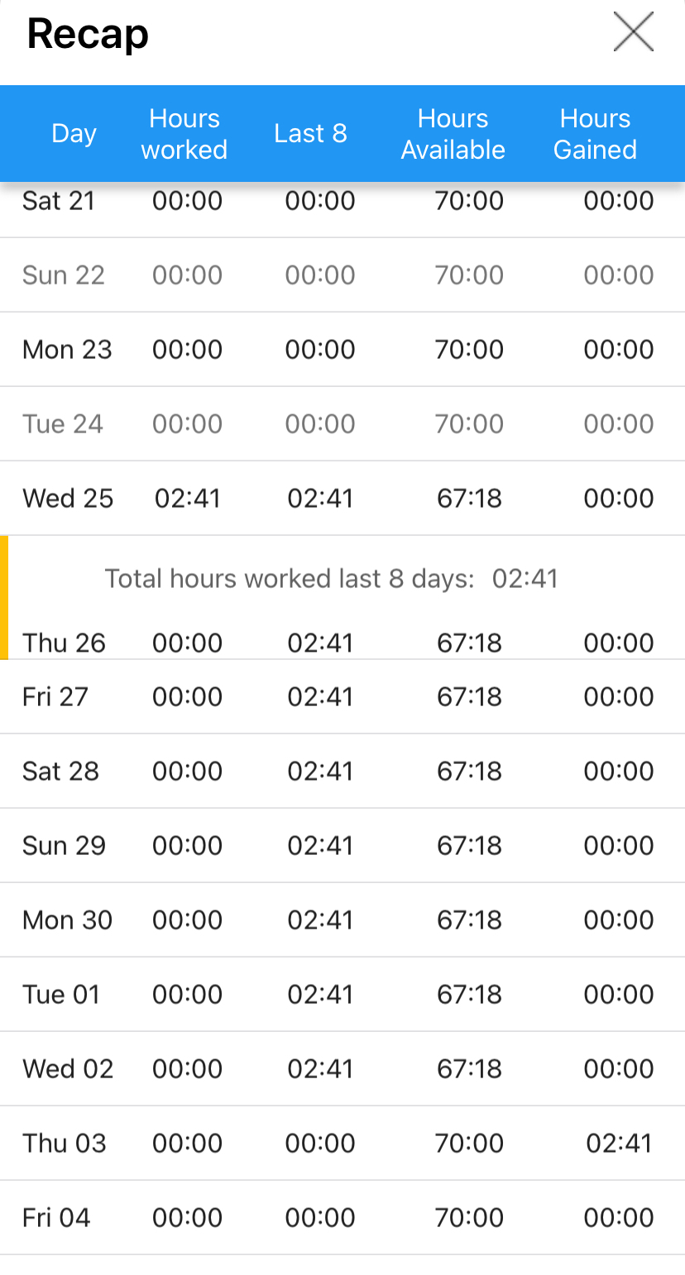
Confirm your Available Shift Time
BEFORE PERFORMING ANY ON DUTY ACTIVITY,
confirm your shift has
reset.
Tap the Time Remaining button to view your time clocks. At the start of each shift you should see 11H Drive Time available and 14H On-Shift time available. RECAP will show additional details.

Slide 6
What am I required to log?
In order to be compliant, you must log all operations of your vehicle, including:
Staging the vehicle for loading
Fueling the vehicle
Pre and Post trip inspections
All driving activity (on and off duty)

Slide 7
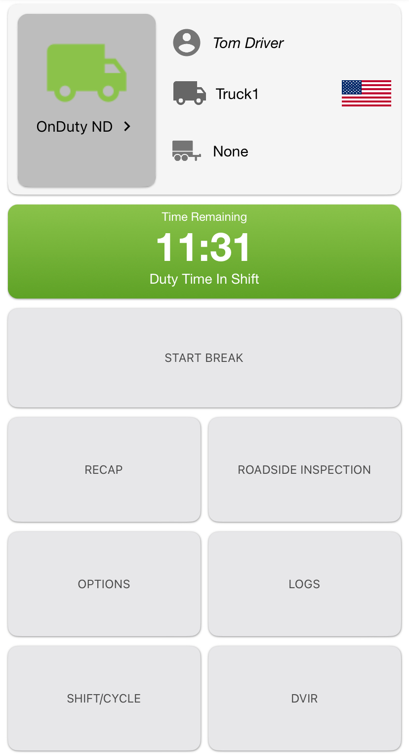
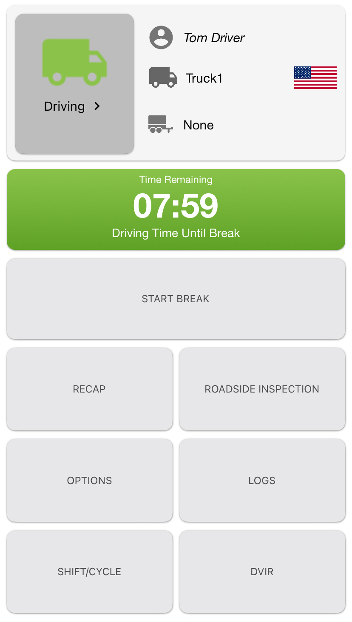
Changing Duty Status
Current Status is “On Duty – Not Driving.”
Current Status is “Driving”
Once the vehicle’s ECM indicates that the vehicle is traveling at a speed of 5mph, the application will automatically transition you to "Driving” status.
The application will also transition to ‘"On Duty - Not Driving“ status automatically, however for that to happen, the vehicle must maintain a speed of 0mph for 6 consecutive minutes.
BEST PRACTICE TIP: Change your status to “On Duty – Not Driving” as soon as you come to a stop, so you don’t lose 6 minutes of drive time waiting for the application to make this change.
Don’t forget to take your break. Press the START BREAK button. The Time Clock will display when you can return to On Duty. The Time Remaining button will turn red if you exceed critical time limitations.

Slide 8
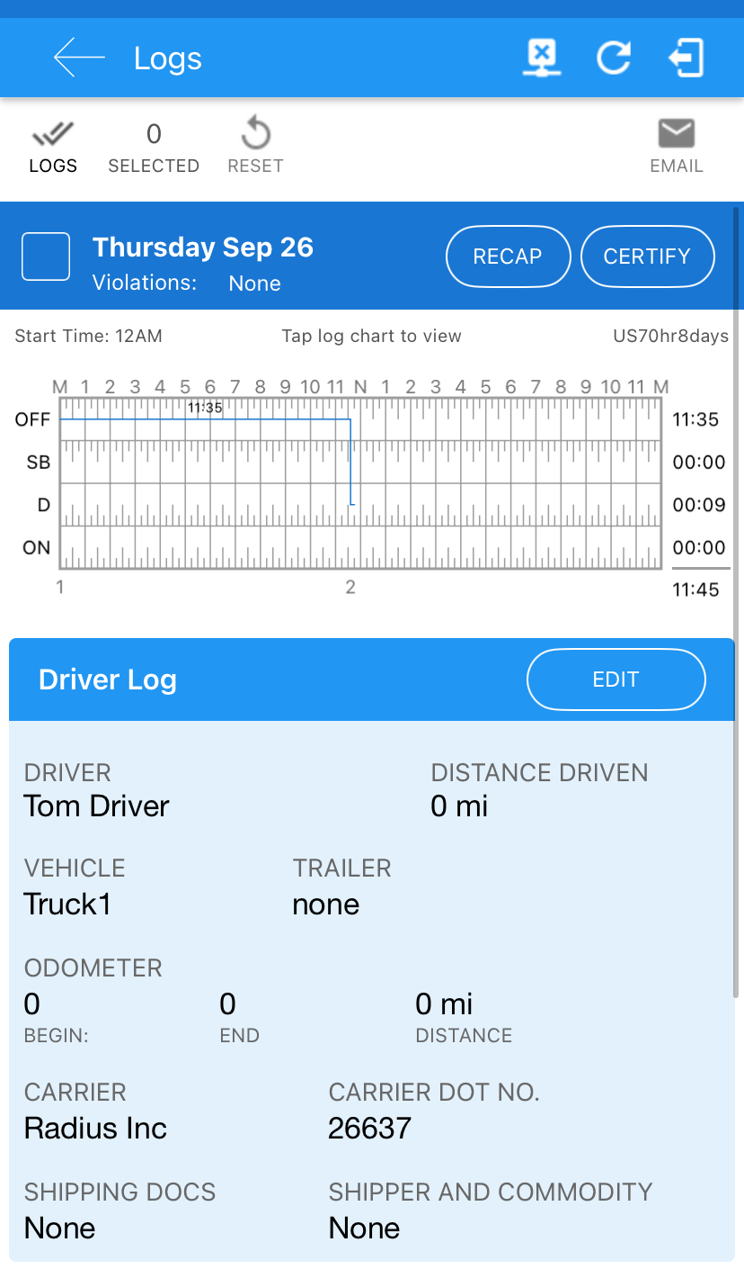
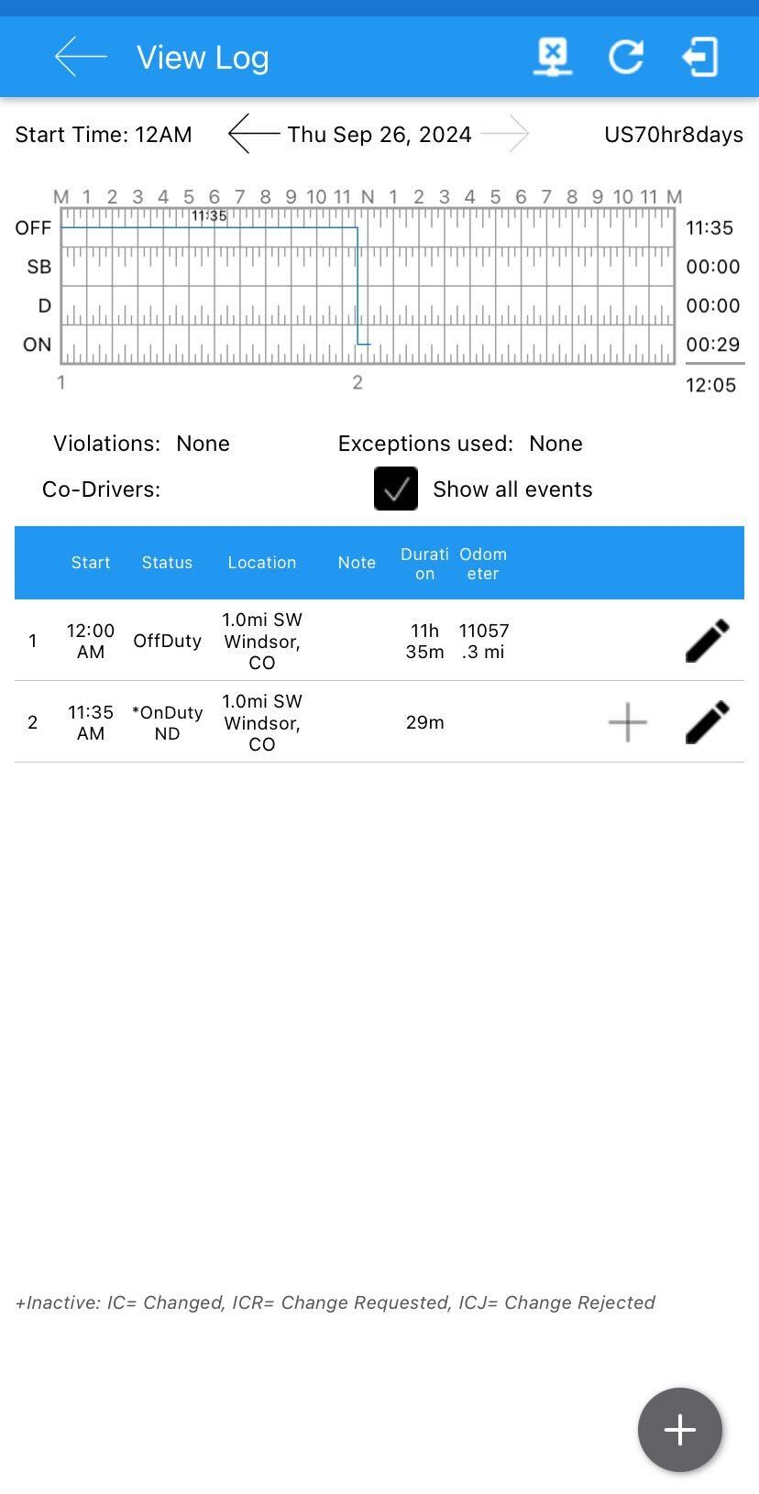
Certifying Logs
Editing Logs
For compliance, a driver must certify all previous logs before beginning a new shift. You will receive a notice upon logging in, if you have uncertified logs.
You can also view logs by tapping the LOGS button on the main dashboard.
Check the box next to the date of the log that you would like to certify, and tap CERTIFY.
You will always be prompted upon logging out to certify any uncertified logs.
If edits need to be made, tap anywhere on the chart to enter Edit Mode. If editing a certified log, you’ll be prompted to uncertify the log to allow you to proceed.
Tap the Pencil icon to edit an existing Event or the + button to add a new Event. Enter the reason for the edit, and press SAVE. An edited event is identified with a + next to it. Tap the + to expand and view the change.
Driving Events cannot be edited. If a Driving Event is inaccurate, add an annotation.
Remember to Certify the log again once your edit is complete.

Slide 9
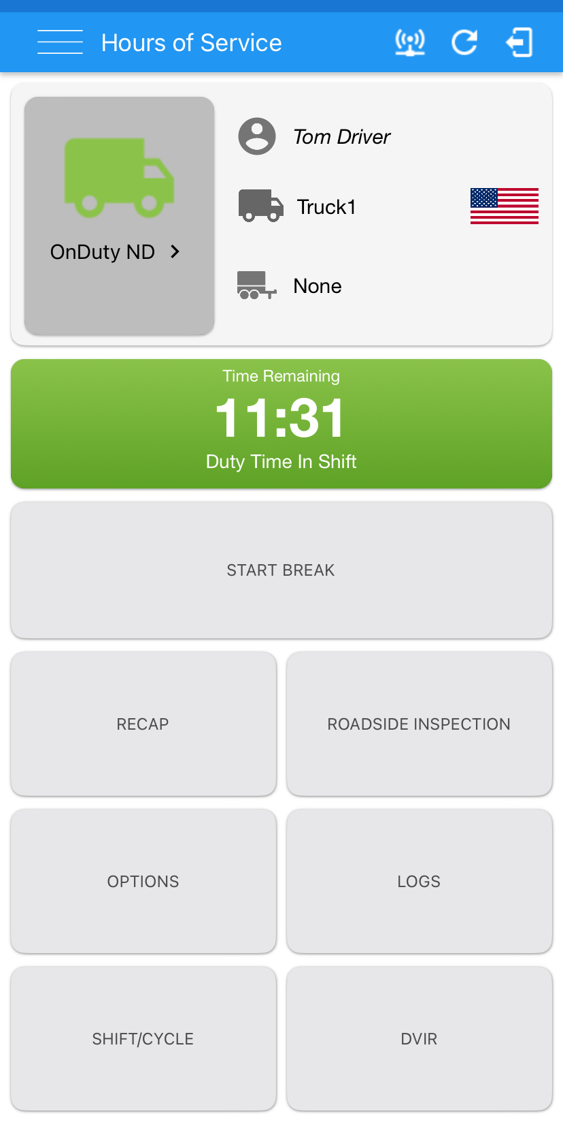
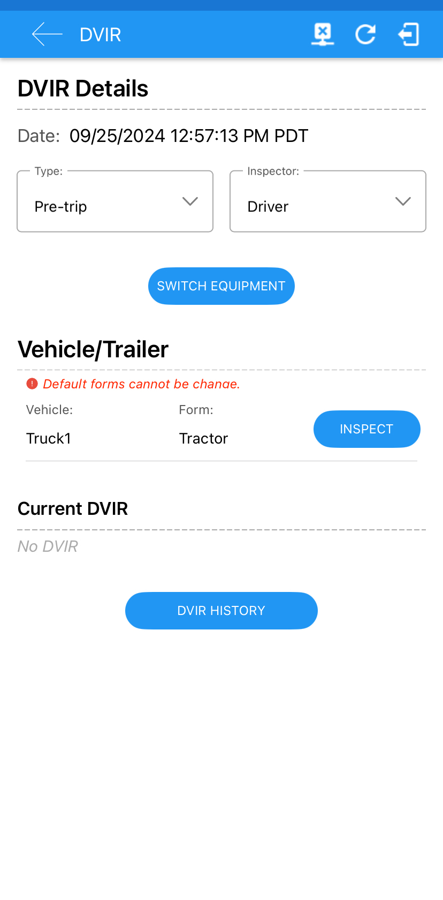
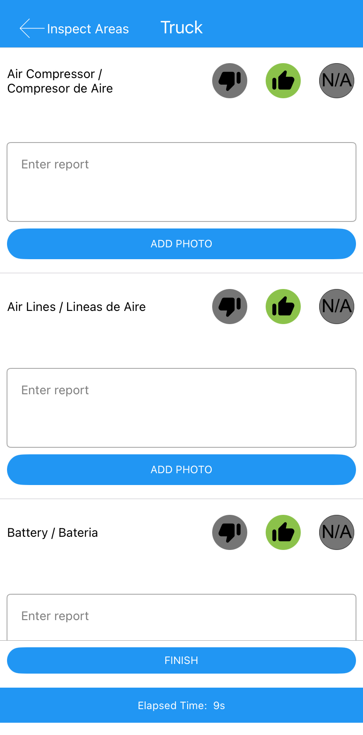
Pre & Post Trip Inspections
Tap DVIR. Select the Type of Inspection, and the Form. Tap INSPECT to begin.
Notate any Points of Inspection which are defective. Add photos if needed. Tap FINISH.

Slide 10
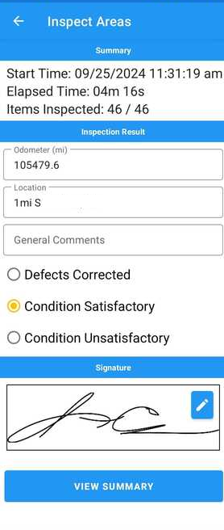
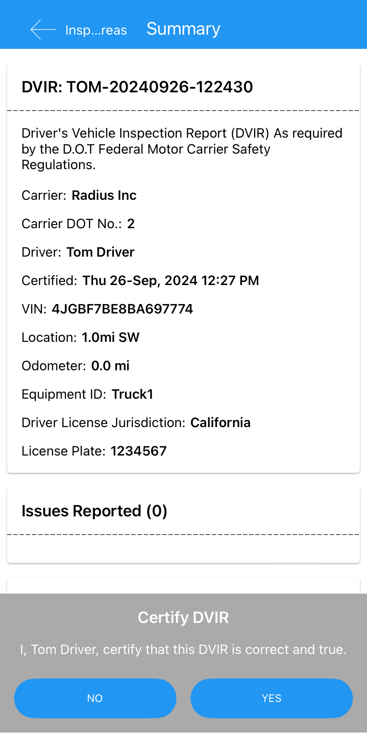
Pre & Post Trip Inspections (Cont’d.)
After all items have been inspected, you will confirm the inspection results, create your signature, and choose to view summary.
Finally, certify that the inspection is complete by choosing YES.

Slide 11
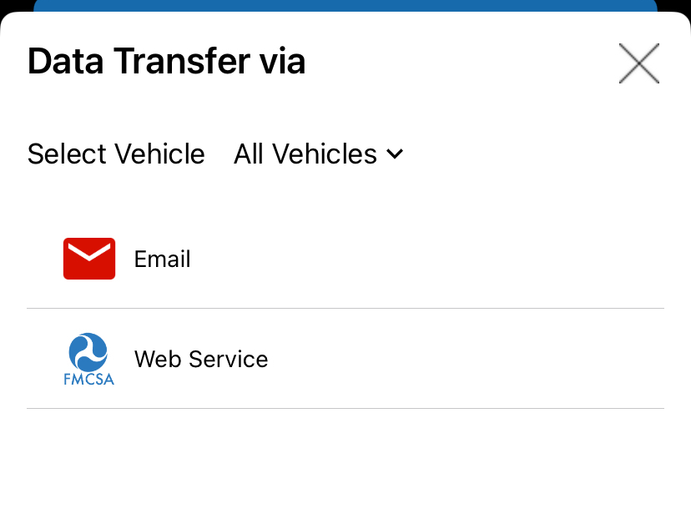
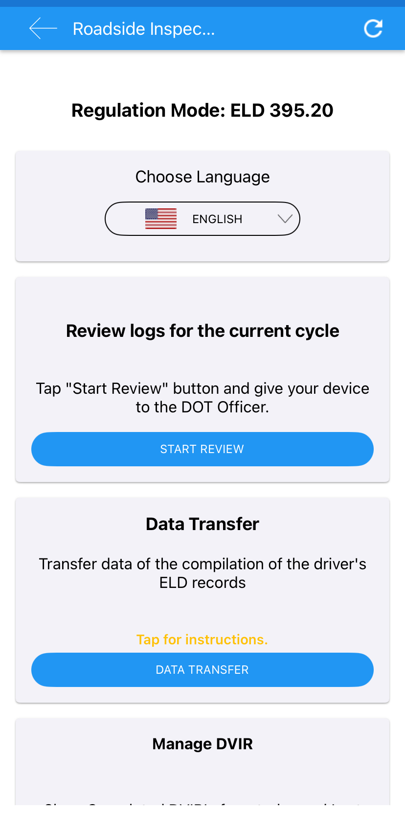
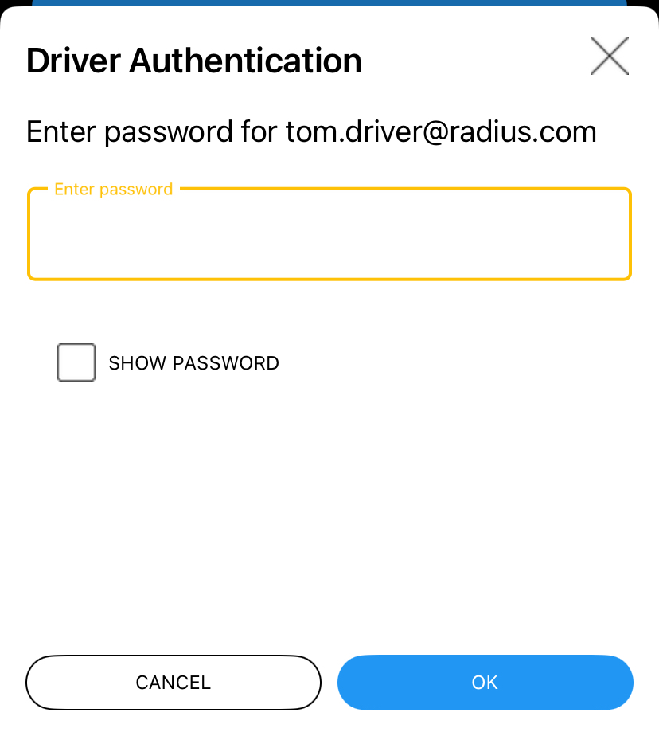
Roadside Inspections
BEFORE PROVIDING YOUR DEVICE TO AN INSPECTOR, PRESS THE ROADSIDE INSPECTION BUTTON. Everything an agent could legally ask for is included on this section.
You can email logs to an individual, or send your records directly to the FMCSA servers.
Press the back arrow to return to the main Hours of Service screen after the inspection is complete. You’ll be prompted to re-enter your password as a protection for you, as a driver.

Slide 12
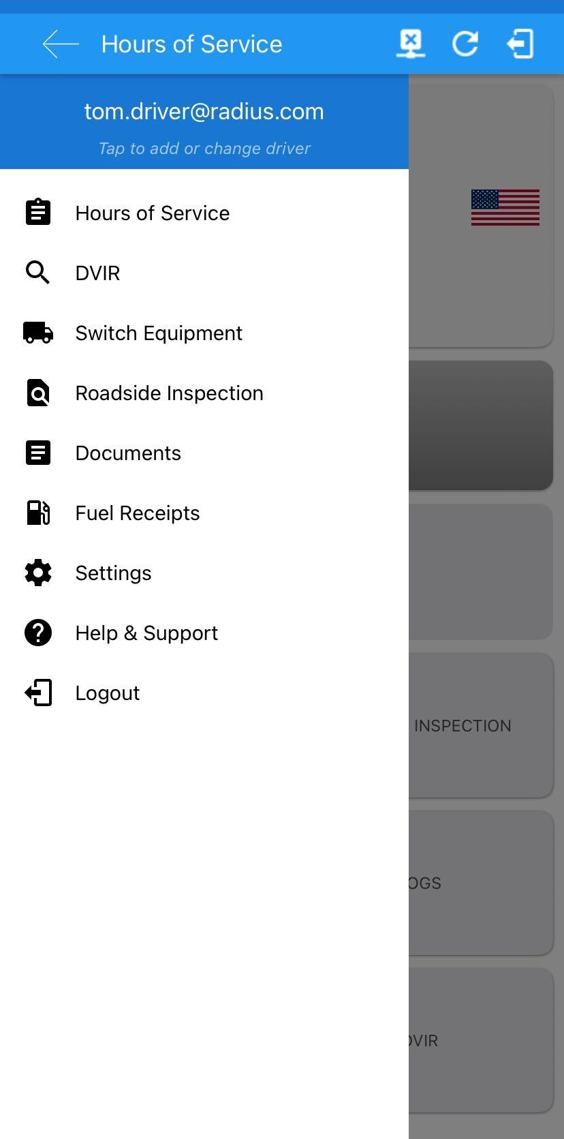
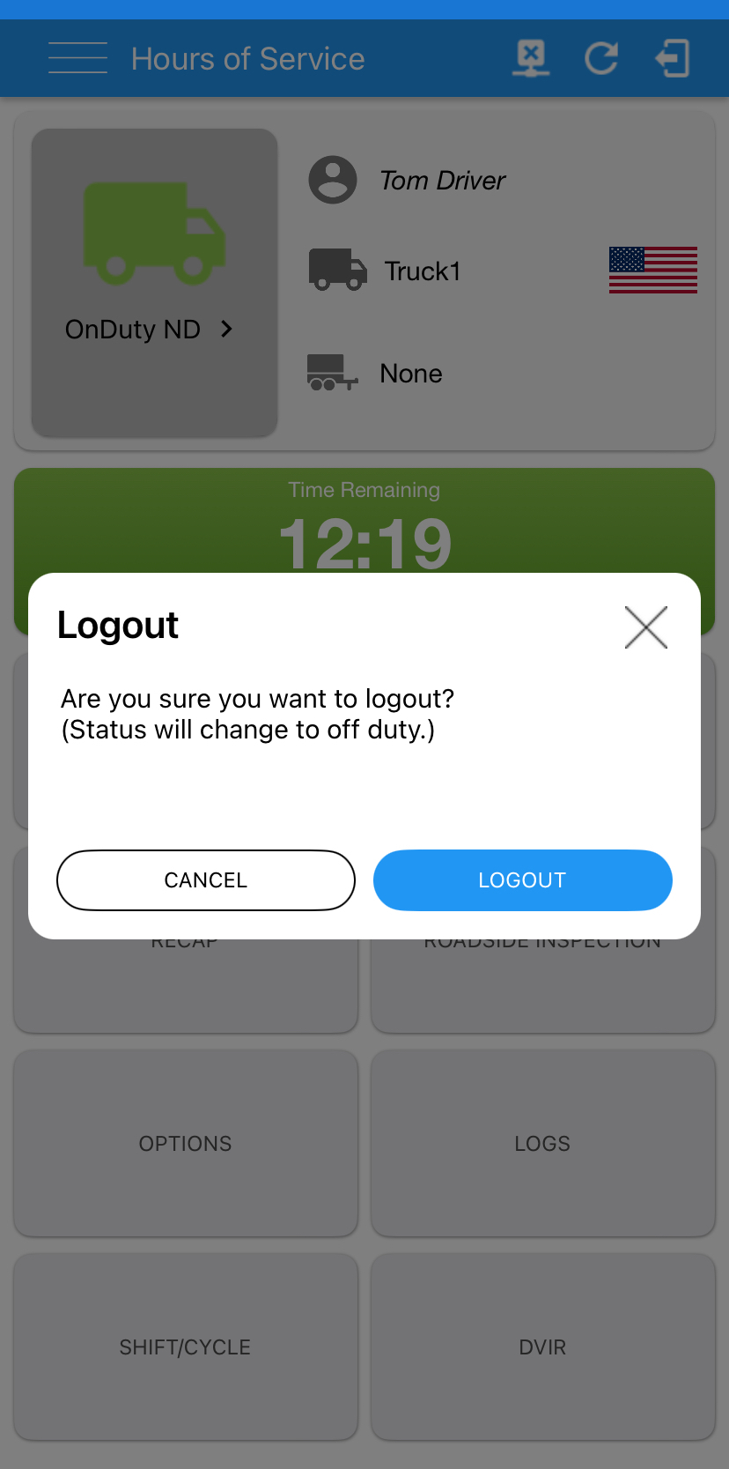
End of Day Procedure
Once your shift is complete, after your Post-Trip Inspection has been performed, you must end the shift in the application and log out. This is a very important step, to ensure your cycle and shift hours calculate properly.
If you attempt to log out while in ON DUTY status, you’ll be notified that your status will change .
Tap the 3 lines to access the Menu, and select Logout.
Scroll to bottom, to access Log Out function.

Slide 13
End of Day Procedure (Cont’d)
If there are any remaining Uncertified Logs, a notice will appear, prompting you to certify your logs.
Once complete, the Log Out will complete and you will be returned to the initial Login Page.

Slide 14
You may revert to paper logs when:
You may NOT revert to paper logs when:
Unable to connect to ELD Device in the vehicle.
Unable to Authenticate (Log-In) to the ELD Application.
Display Device (tablet/phone) will not turn on (i.e. broken or battery is dead).
Note: You are only allowed to operate on a paper log for up to 8 consecutive days, after which the ELD issue must have been resolved.
Log is displaying incorrect information.
Log is showing that you are operating in violation (i.e. no time available).

Slide 15
Reminders
Always remember
Log in & log out every day.
Ensure you are capturing all work related on duty time.
Certify your previous days logs prior to departing for the day.
Confirm eligibility to drive.
Make sure you have connected and stay connected to the truck.
Before you exit the vehicle, change your status.
Change your status to off duty at end of day.
Log out of the application every day.

Slide 16
Radius Support
eldsupportna@radius.com
888-278-9781

