Slide 1
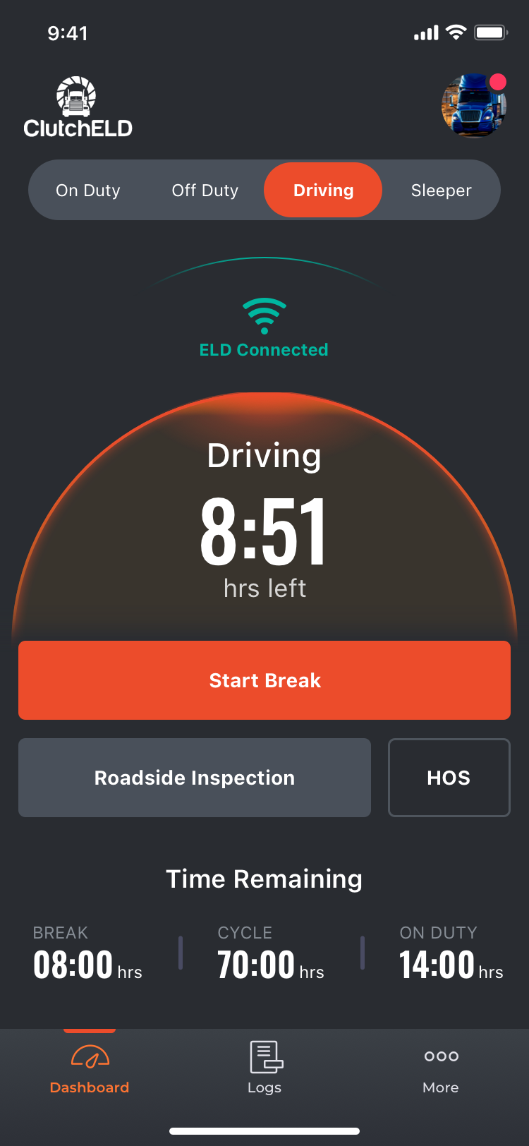
Geometris Hardware

